Slide 1
Organizing your compare/contrast essay
Superman vs batman

Slide 2
Writing prompt
THE FILMS MAN OF STEEL AND THE DARK KNIGHT RISES PRESENT TWO EXAMPLES OF SUPERHEROES, SUPERMAN AND BATMAN. In a well-supported essay, compare superman and batman and explain how well they represent the classic definition of a superhero.

Slide 3
Example thesis statement (weak)
1. In the movies man of steel and the dark knight rises, the archetypal superhero is portrayed differently.

Slide 4
example thesis statement (still weak)
While both man of steel and the dark knight rises present the archetypal superhero as a crusader for justice, they each present superheroes differently.

Slide 5
Example thesis statement (good)
While Man of steel presents Superman as meeting the traditional definition of a superhero, The dark knight rises changes how readers understand superheroes by presenting Batman as an angry and troubled character.

Slide 6
Organizing a compare/contrast essay
The block method
Point-by-point method

Slide 7
Block Method outline (subject by subject)
Introductory paragraph with thesis
Assertion about Topic 1
A. 1st Supporting detail, example, or evidence
B. 2nd supporting detail, example, or evidence
c. 3rd supporting detail, example or evidence
Assertion about topic 2
a. 1st Supporting detail, example, or evidence
b. 2nd Supporting detail, example, or evidence
c. 3rd supporting detail, example or evidence
Concluding paragraph

Slide 8
Point by point outline
Introductory Paragraph with thesis
Assertion
a. Point about Topic 1
b. point about topic 2
Assertion
  a. point about topic 1
  b. point about topic
Assertion
  a. point about topic 1
  b. point about topic
  Concluding Paragraph

Slide 9
Essay examples
Prompt: the films Man of steel and the dark knight rises present two examples of superheroes, superman and batman. In a well-supported essay, compare superman and batman and explain how well they represent the classic definition of a superhero.

Slide 10
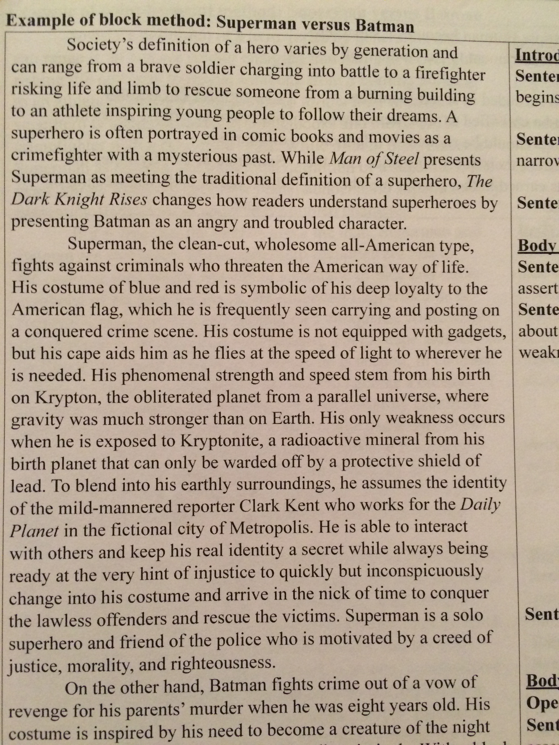
Block method

Slide 11
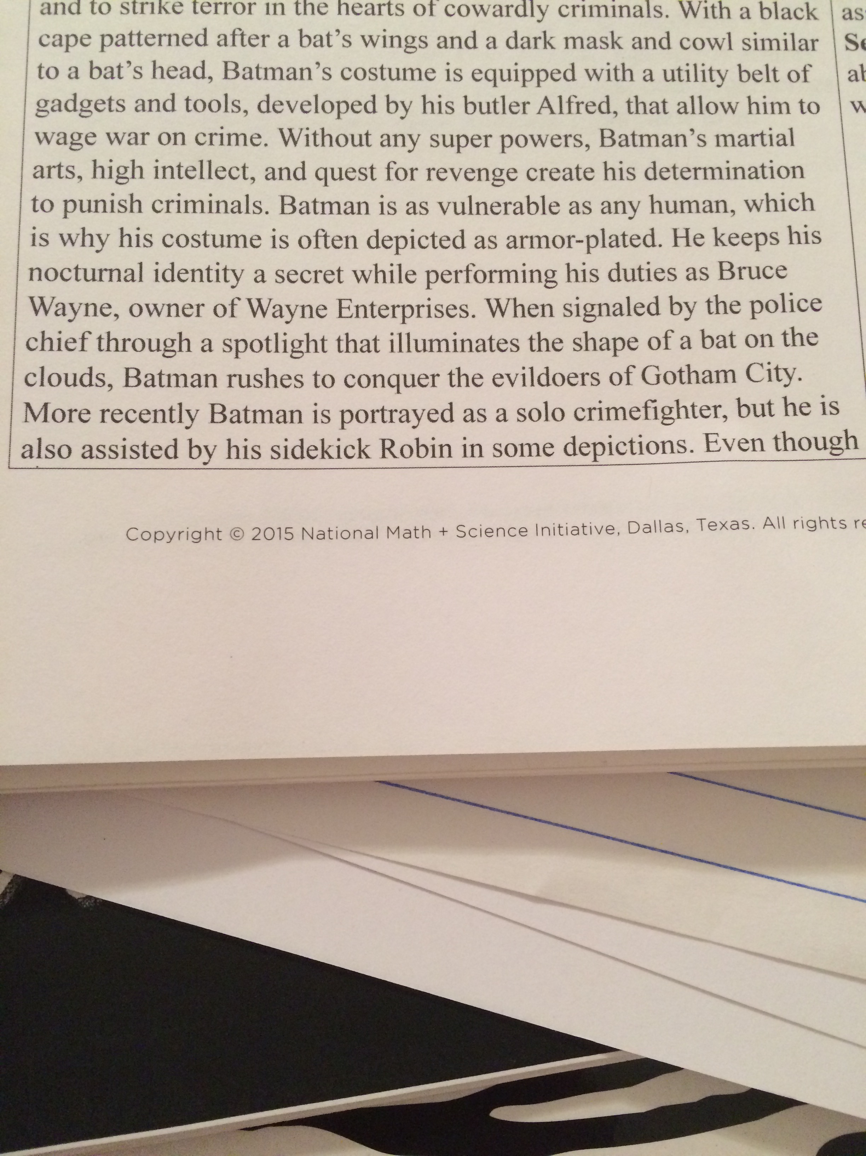
Block method

Slide 12
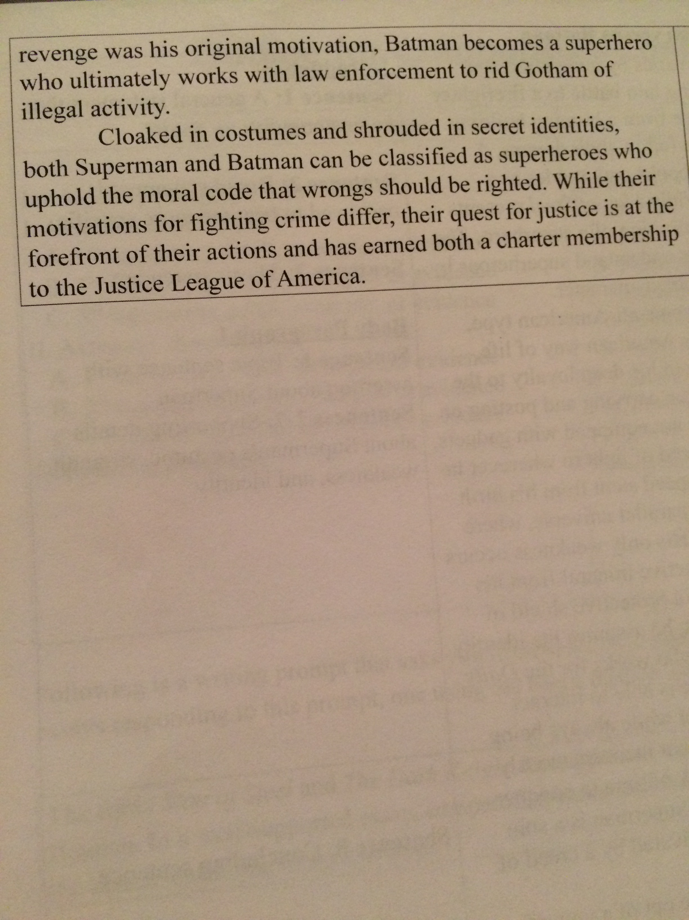
Block method

Slide 13
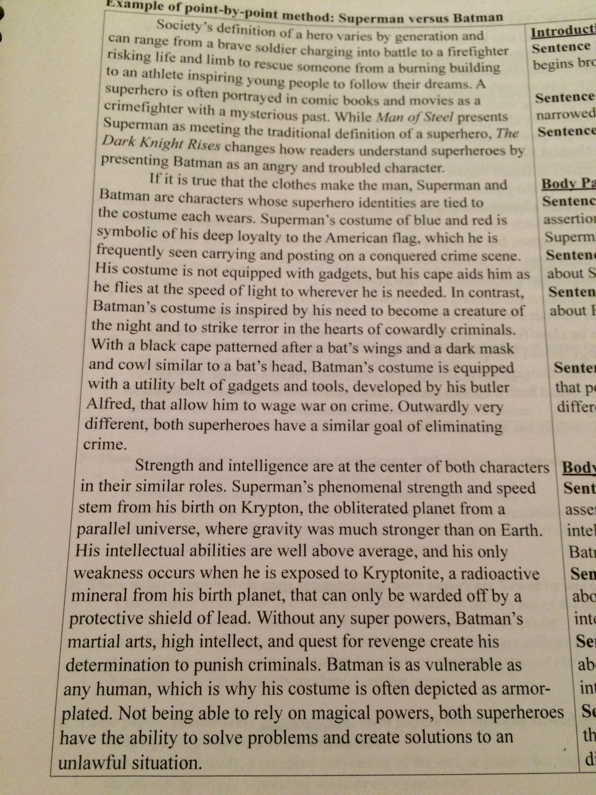
Point by point method

Slide 14
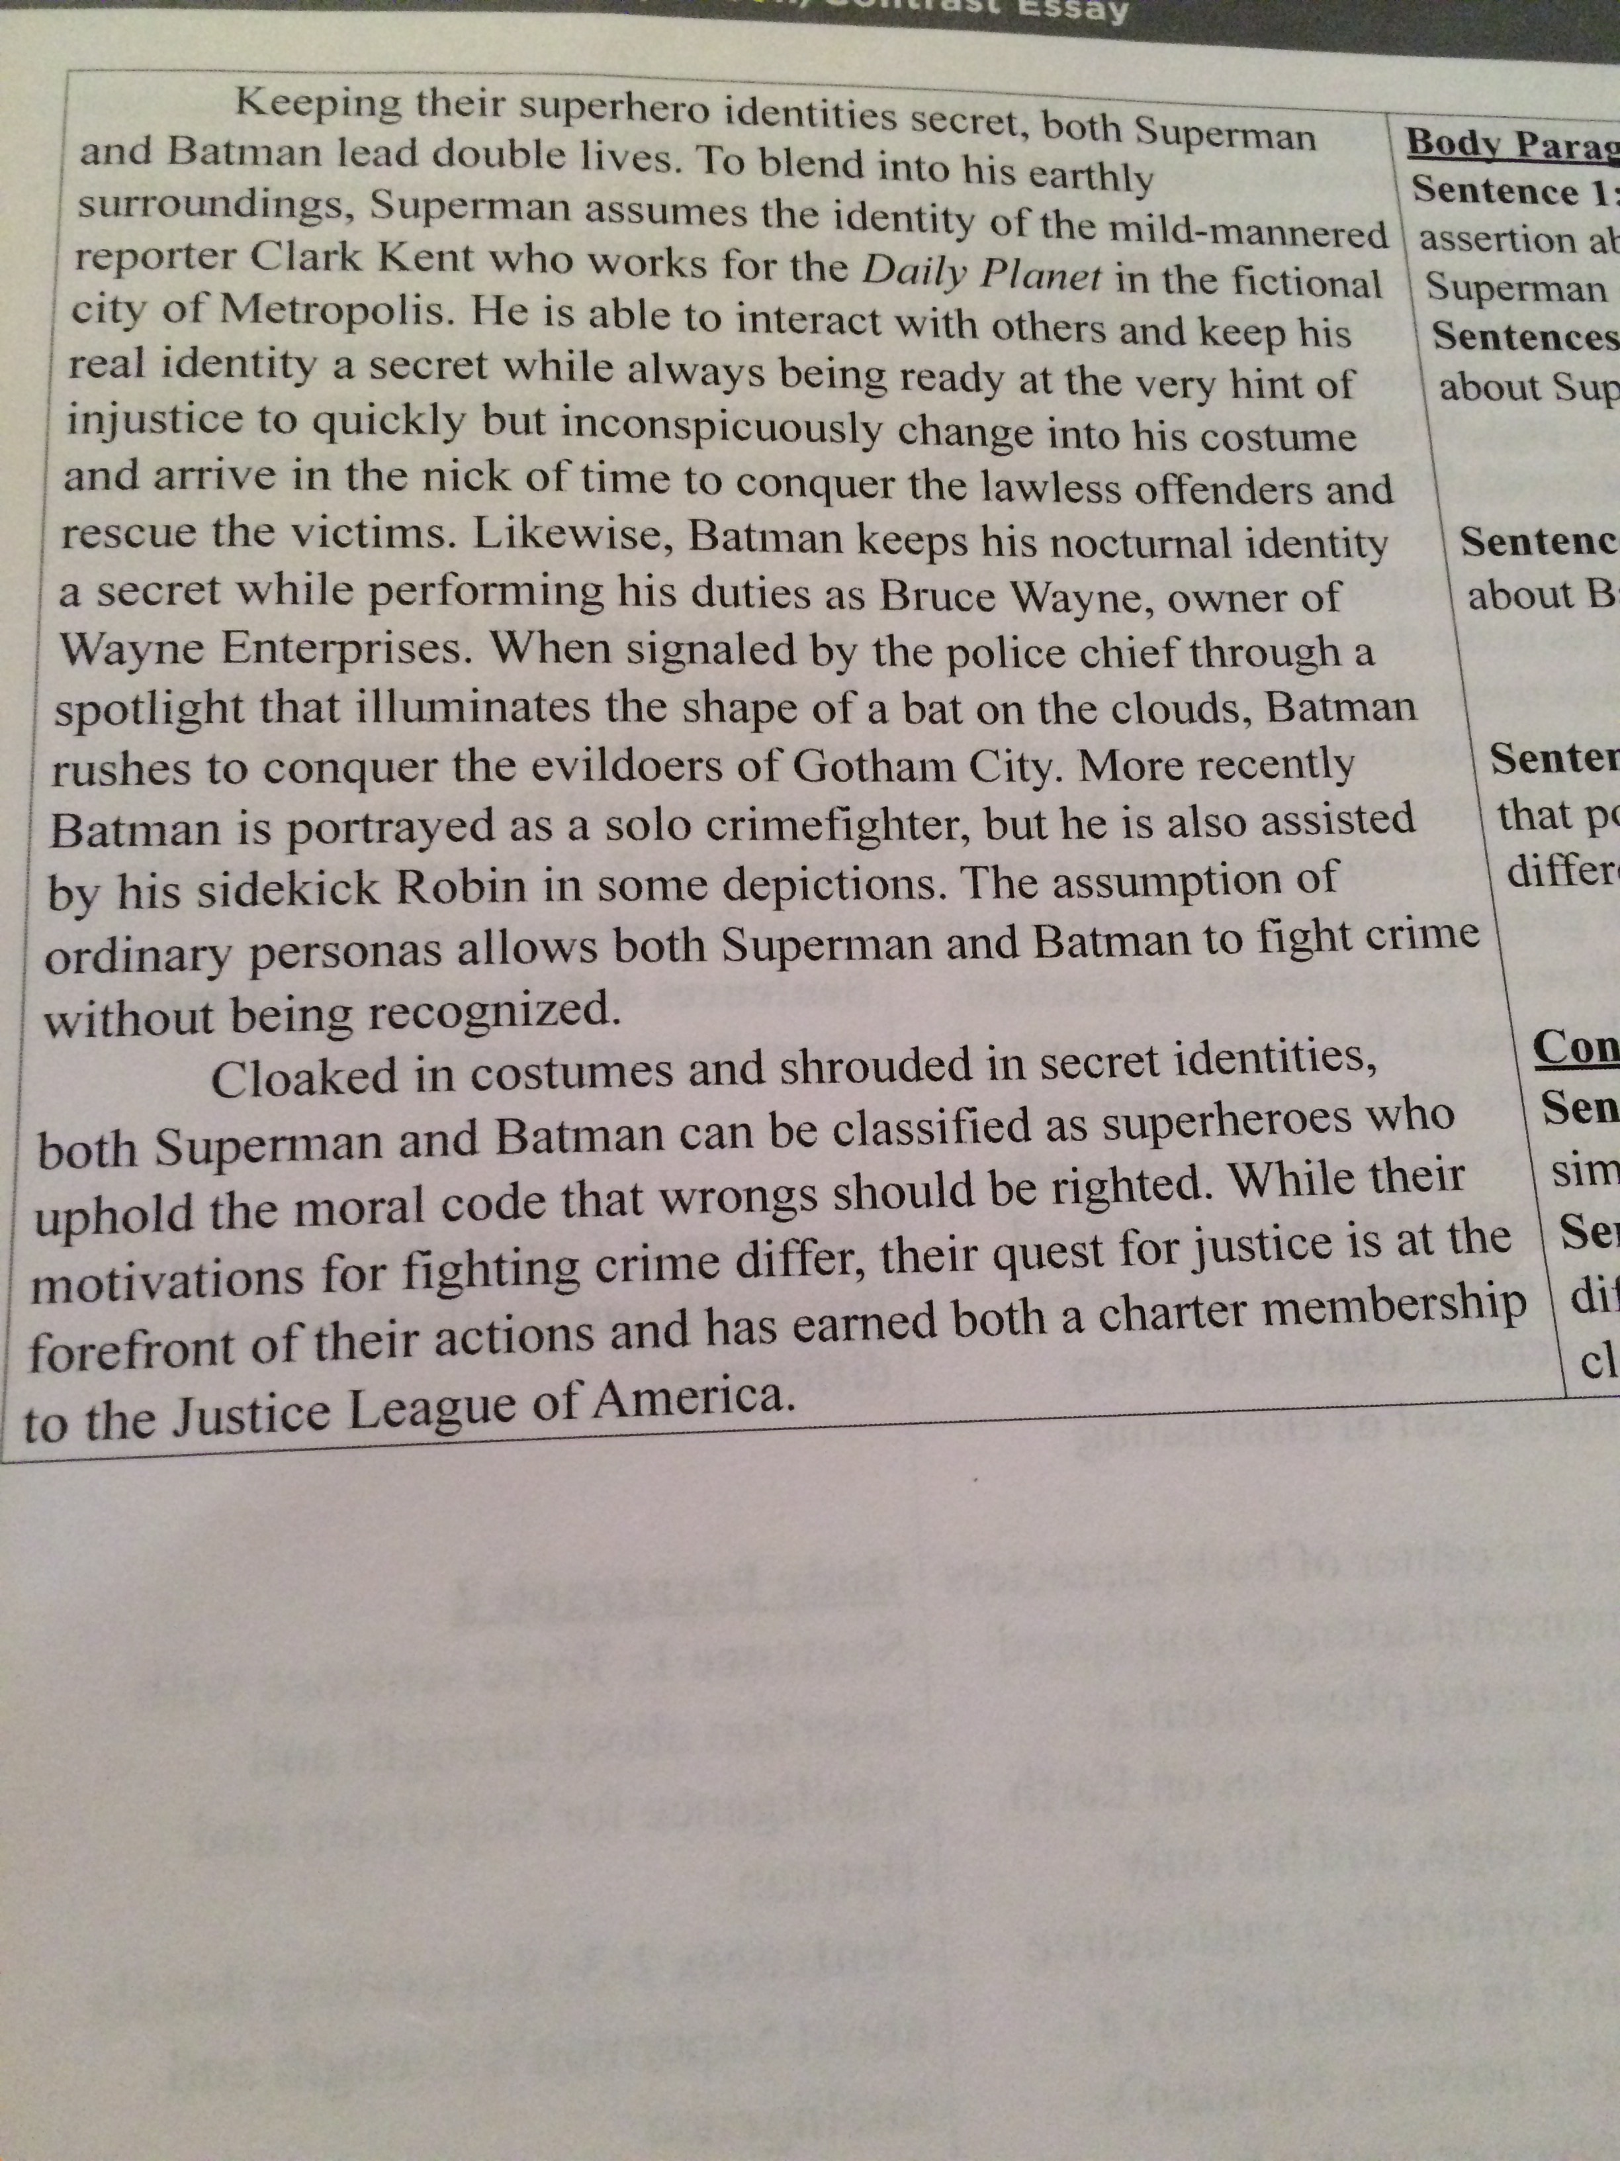
Point by point method

